Slide 1
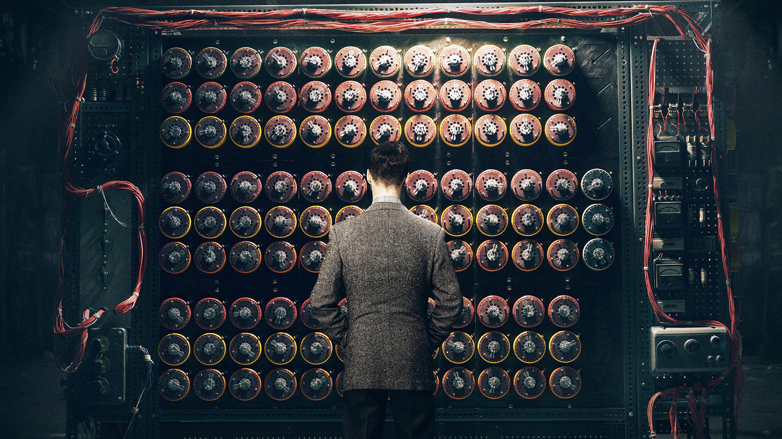
ALAN TURING
AND
THE ENIGMA CIPHER
LECTURER: MAI DUC TRUNG
Group: Enigma
RECOMMEND TO USE POWERPOINT 2016 OR ABOVE FOR EXPERIENCING MORPH TRANSITIONS

Slide 2
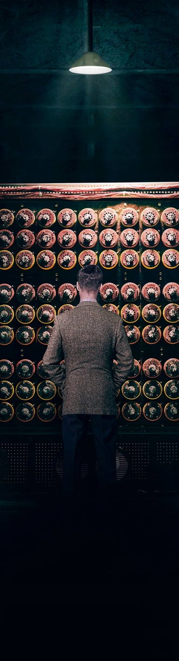
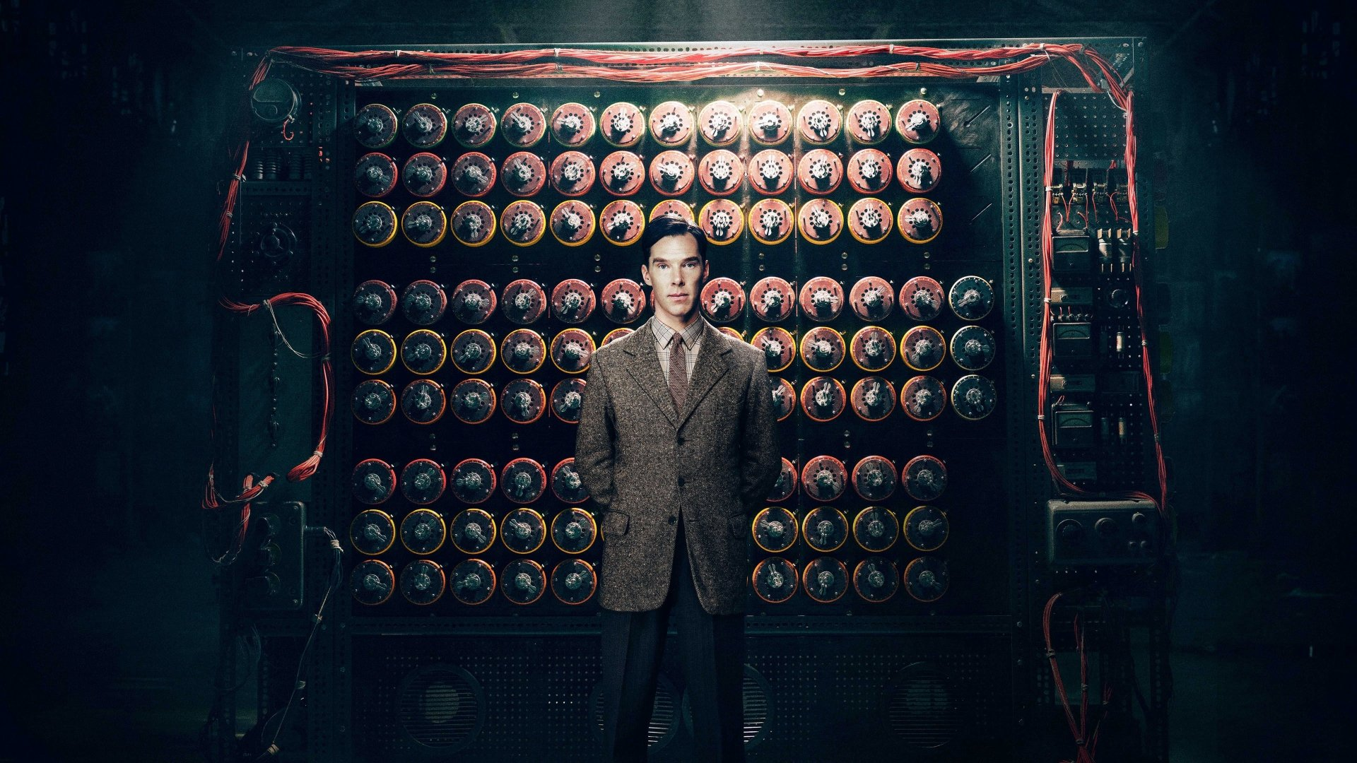
CONTENT
The Enigma Machine
Alan Turing – The Code Breaker
Breaking the Enigma
Results

Slide 3

Preface
THE IMITATION GAME
Alan Turing (played by Benedict Cumberbatch in The Imitation Game)

Slide 4
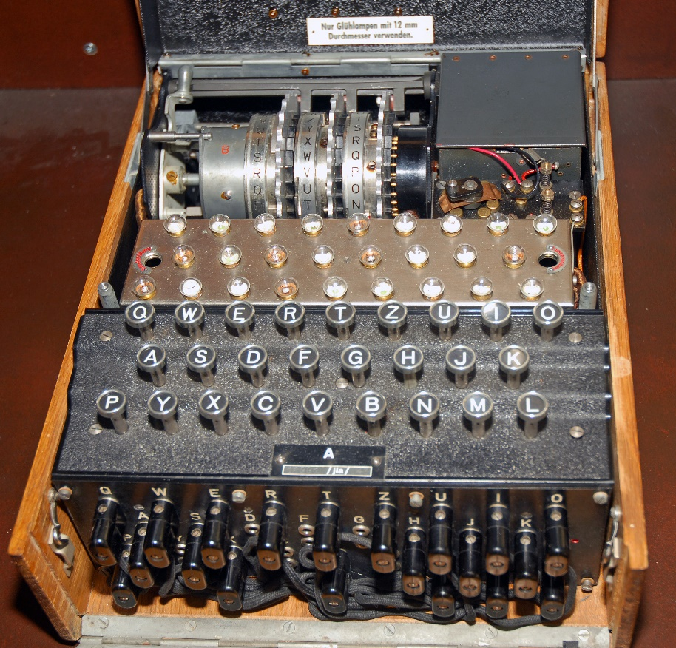
Enigma Machine
used a scheme that was quite similar to what we call QWERTY
26 buttons
3 physical rotors
Different letters output
More than 17,000 combinations of letters to create codes
ENIGMA

Slide 5
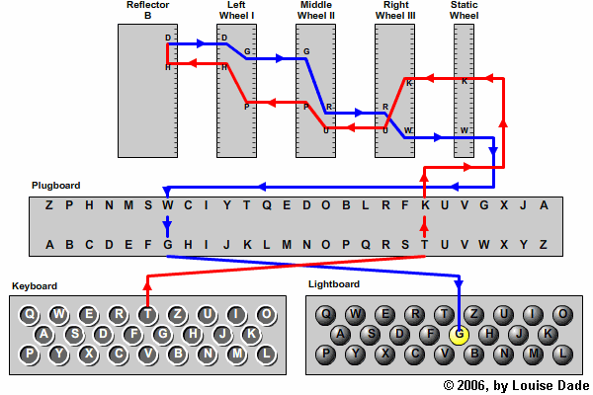
Letters from keyboard
→ plugboard (switch letter)
→ Three physical rotors
→ Reflector
→ Three physical rotors
→ Plugboard
→ Lightboard
ENIGMA

Slide 6
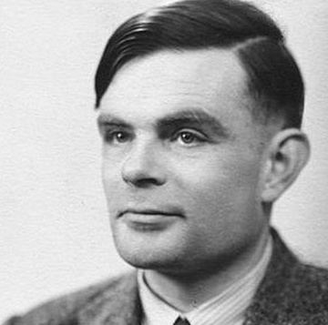
Alan turing
THE CRACKER OF ENIGMA
Alan Mathison Turing
23/6/1912 – 7/6/1954
Mathematician, logician
Made major impact to victory against Nazis during World War II
LAID A GROUNDWORK FOR AI revolution
Alan turing

Slide 7
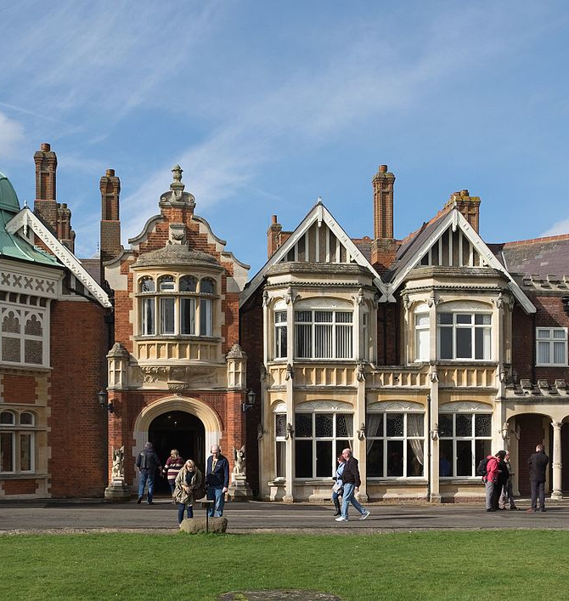
BREAKING THE ENIGMA
Bletchley Park
Buckinghamshire, England (today)

Slide 8


Slide 9
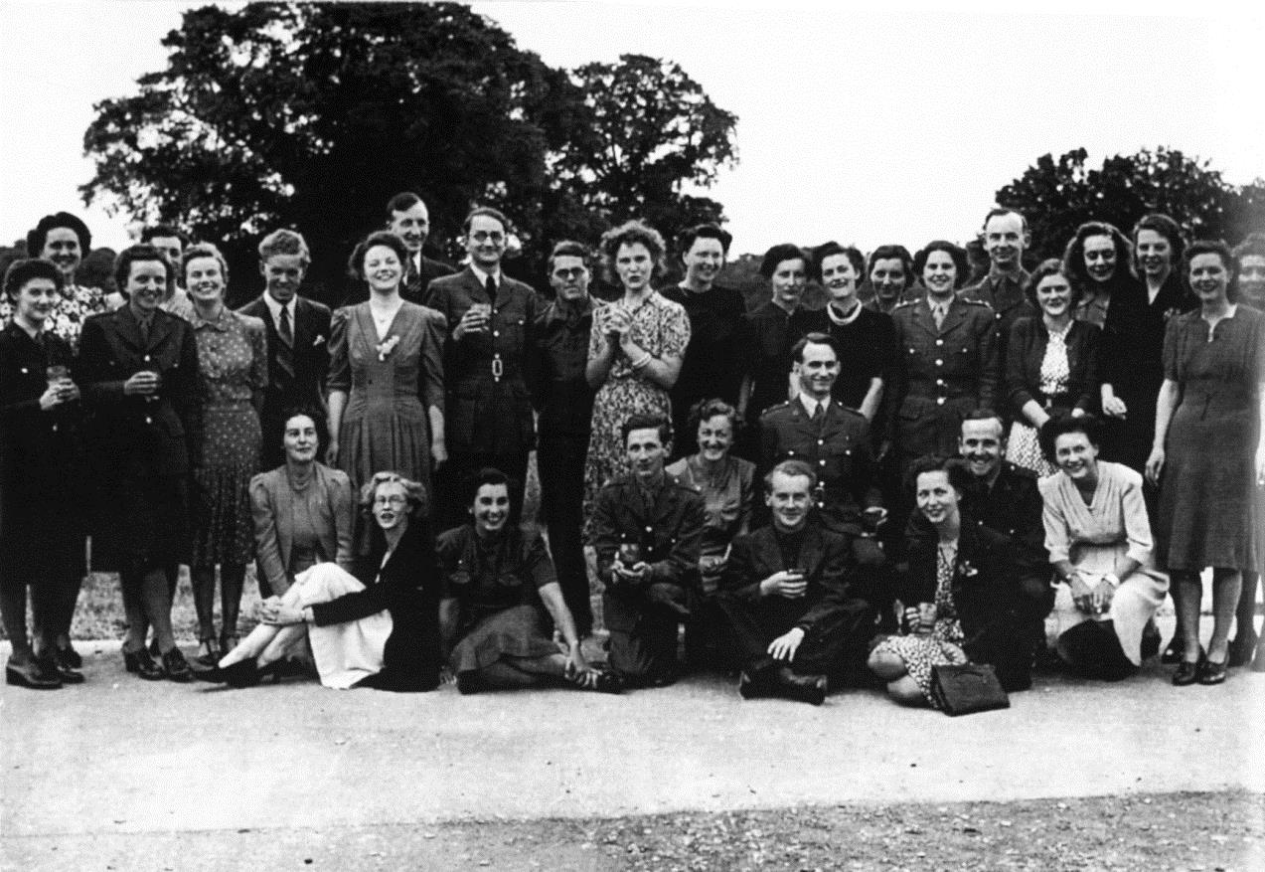
ultra

Slide 10
DIFFICULTIES
AGAINST GERMAN ENIGMA
changing the cipher system daily
Although Allied disposed money in huge numbers, they were not able to decipher Enigma.
They could not even get close to breaking the code used by Germans.
Breaking enigma

Slide 11
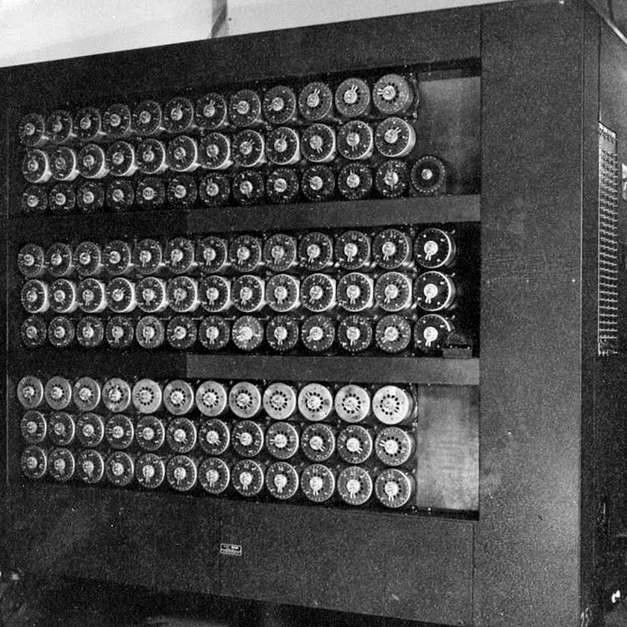
BOMBE
ANCESTOR OF MODERN COMPUTER
A ton of weight
housed in a bronze-coloured metal cabinet
Arranged in three 12 x 3 arrays
Searched all the settings and disregarded those that were incorrect
By disproving thousands of rotor settings, those left were possible correct settings”. That process was called “Banburismus”
Breaking enigma

Slide 12
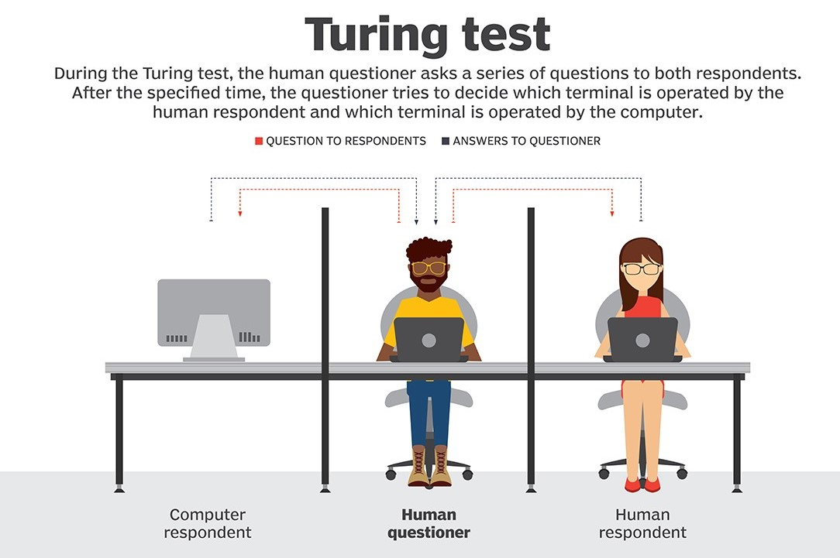
In 1952, Alan Turing was arrested for homosexuality – which was then illegal in Britain.
In 1954, he was found dead from cyanide poisoning.
An inquest ruled that it was suicide.
In February 1946 (Turing post-war life), he presented paper on designing Automatic Computer Engine.
Alan Turing suggested the experiment called “Turing’s test” that could prove or not whether machines could think or not.
results
Post-war

Slide 13

References
Wartime picture of Bletchley Park Bombe machine named Victory
https://www.britannica.com/topic/Bombe
Alan Turing https://www.britannica.com/biography/Alan-Turing
Ultra the Secret Bletchey Code-breaking Team https://www.britannica.com/topic/Ultra-Allied-intelligence-project
Turing test https://medium.com/@vuongptnguyen/evaluating-artificial-intelligence-from-turing-test-to-now-b64a8fced070
Bletchley Park and Alan Code-Breaking Team https://www.cia.gov/news-information/featured-story-archive/2015-featured-story-archive/the-enigma-of-alan-turing.html
How The Enigma works? http://enigma.louisedade.co.uk/howitworks.html

Slide 14
THANK YOU FOR YOUR ATTENTION

